Slide 1
Smart Agriculture System Based On IOT- SB38297
Project ID : SPS_PRO_101
Application ID : SPS_APL_20200038297 Guide Name : Durgaprasad
Developer Name : Sagar Shahuraj Jadhav.

Slide 2
Project Description :
Smart Agriculture System based on IoT can monitor soil moisture and climatic conditions to grow and yield a good crop.
The farmer can also get the realtime weather forecasting data by using external platforms like Open Weather API.
Based on all the parameters he can water his crop by controlling the motors using the mobile application.
Here we are using the Online IoT simulator for getting the Temperature,Humidity and Soil Moisture values

Slide 3
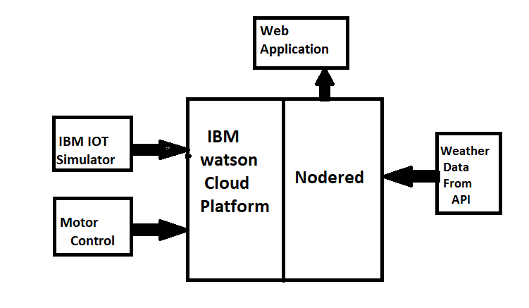
Block Diagram :

Slide 4
Flow Of The Project :
Install node red locally
Create IBM account and explore IBM platform
Connect IOT Simulator to watson IOT Platform
Configure nodered to get data from IBM IOT platform and Open Weather Api
Configure nodes to display weather parameter
Configure nodes for creating buttons
Python code to subscribe ibm iot platform

Slide 5
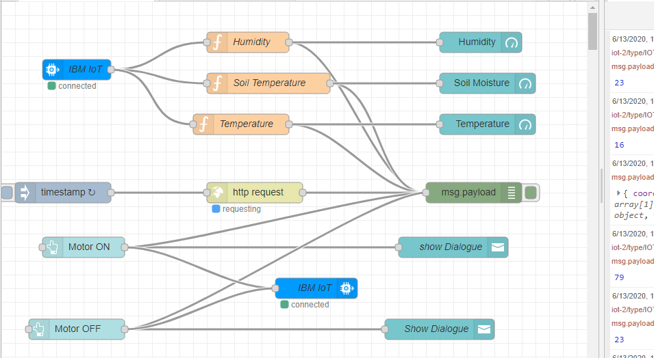
Node Red Flow :

Slide 6
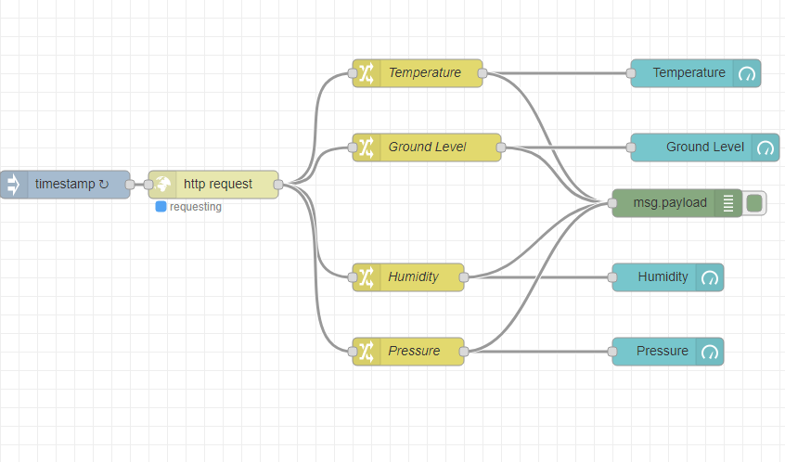
Node Red Flow For Open Weather API :

